Slide 1
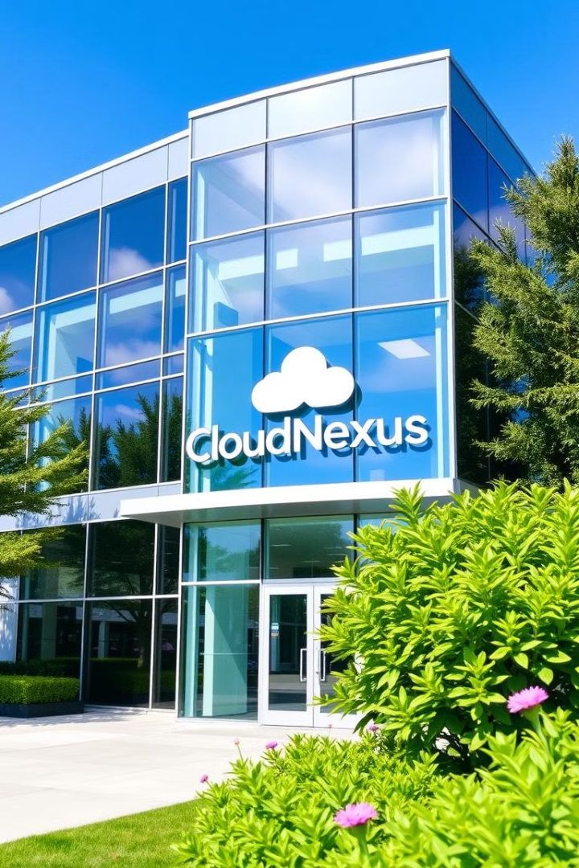
CloudNexus, Secure Network Architecture for the Digital Age
CloudNexus, a dynamic and progressive company, specializes in cutting-edge cloud solutions for global customers. With a team of 600 talented experts, CloudNexus focuses on creating and executing customized cloud-based solutions to meet the evolving needs of businesses across various sectors. As the company prepares to relocate to a larger facility, a new network service must be developed and implemented to ensure strong security and seamless operations in the digital world.

Slide 2
Agenda
The Challenge: Securing a Growing Enterprise
Network Security Zones
Core Infrastructure Components
Wireless and VoIP Infrastructure
IP Address Allocation
VLAN Configuration and Inter-VLAN Routing
Advanced Network Features
Security Measures and Access Control
Final Network Topology and Testing

Slide 3
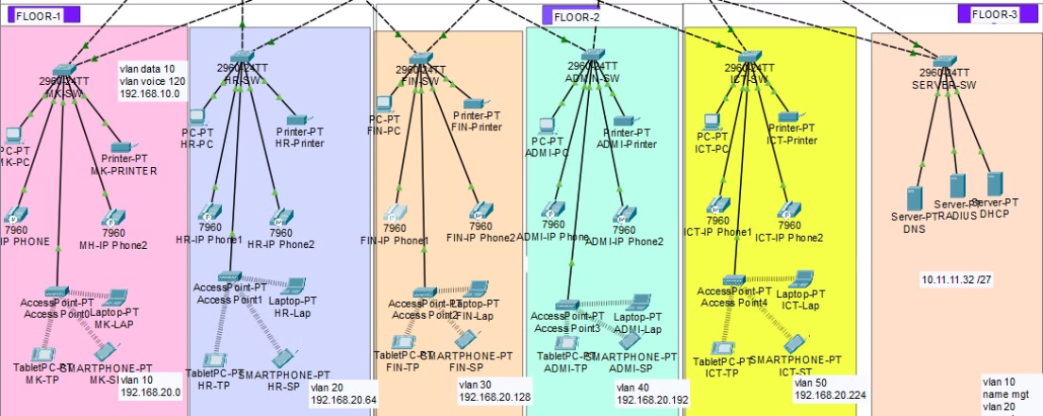
The Challenge: Securing a Growing Enterprise
CloudNexus is expanding and moving to a new three-story building. The facility will house various departments, including a server room, ICT administration, public relations, finance and accounts, human resources, logistics, and sales and marketing. The ICT department comprises diverse roles such as project managers, business analysts, software developers, cloud engineers, cybersecurity engineers, network engineers, system administrators, and IT support specialists.
The challenge lies in developing and implementing a new network service that can accommodate this growth while ensuring robust security against both external and internal threats.
1
Current State
600 employees in existing facility
2
Transition
Relocation to new three-story building
3
Future State
Expanded operations with secure network architecture

Slide 4
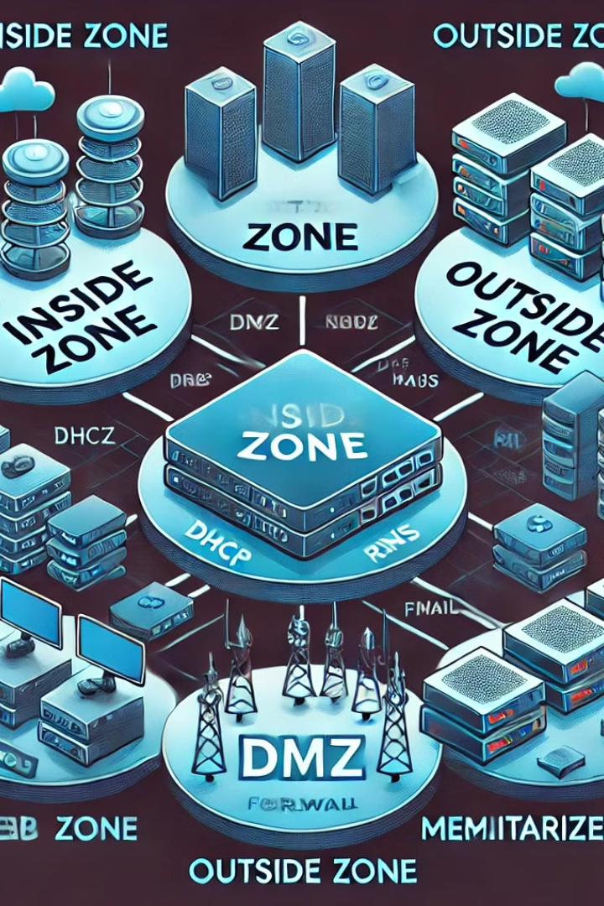
Network Security Zones
To ensure strong security, CloudNexus will implement a firewall divided into three security zones: inside, outside, and DMZ (Demilitarized Zone). Critical servers, including Active Directory (AD), DHCP, DNS, and Radius, will be strategically placed in the inside zone. The DMZ will host servers for FTP, WEB, email, applications, and network storage.
This careful planning and implementation of security measures will not only protect the network but also guarantee seamless operations in CloudNexus' new premises.
Inside Zone
Critical servers: AD, DHCP, DNS, Radius
Outside Zone
External network connections
DMZ
FTP, WEB, email, applications, network storage

Slide 5
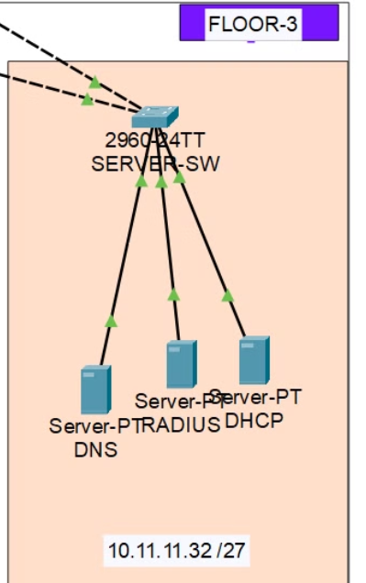
Inside Zone
The internal network will be placed within the Inside Zone of the firewall, providing a secure environment for critical network services. This zone will house essential servers such as DHCP, DNS, and Radius, which are responsible for dynamic IP allocation, domain name resolution, and network authentication, respectively. By isolating these services in the Inside Zone, the network ensures secure management of internal resources, protecting them from external threats while maintaining efficient communication and operational stability within the organization. This setup strengthens security and enhances internal service reliability.

Slide 6
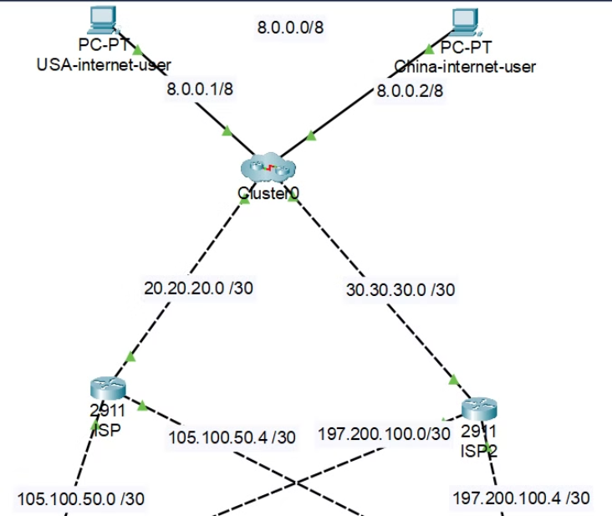
Outside Zone
External network connections represent the interfaces between the organization's network and outside systems, such as the internet and external partners. These connections typically reside in the Outside Zone of the firewall, providing access for public-facing services while safeguarding internal resources. Proper security measures, like firewalls and intrusion detection systems, are essential to manage and secure external communications, preventing unauthorized access while maintaining connectivity.

Slide 7
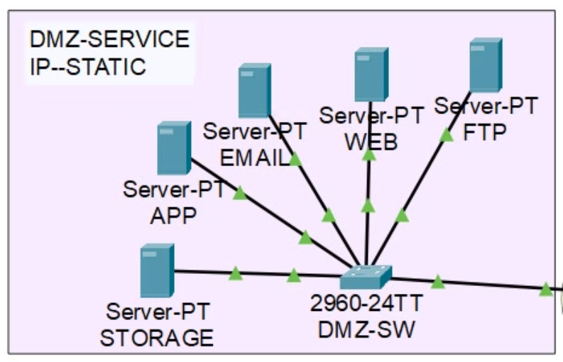
Demilitarized Zone (DMZ),
Servers such as FTP, WEB, Email, Application, and NAS storage will be strategically placed in the Demilitarized Zone (DMZ). This zone acts as a buffer between the internal network and the external environment, allowing secure access to these essential services while protecting the internal network from potential threats. The DMZ can be connected to any firewall, ensuring flexibility in security management. By carefully deploying these security measures, CloudNexus will ensure robust protection and smooth operations in its new building, supporting business continuity and network integrity.

Slide 8
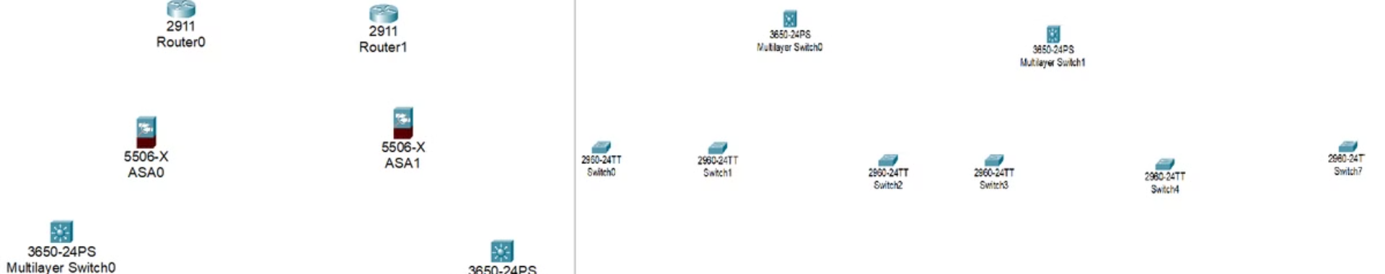




Core Infrastructure Components
CloudNexus' new network design incorporates several essential components to ensure robust and secure operations:
ISPs
Cisco ASA Firewalls
Switching Infrastructure
Virtualized Servers
Redundant internet connectivity
Two 5500-X series for enhanced security
Two physical servers running multiple VMs
Catalyst 3850 and 2960 switches

Slide 9
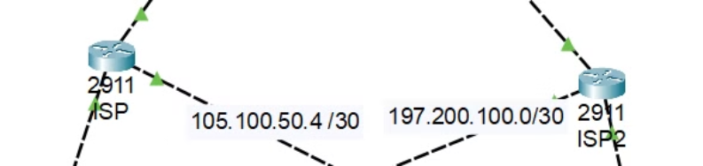
ISPs
The organization has set up a dual ISP subscription (1 & 2) in order to guarantee redundant internet connectivity.

Slide 10
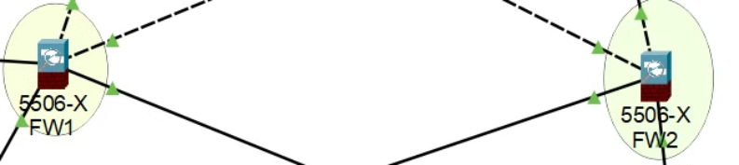
Cisco ASA Firewalls
two Cisco ASA Firewalls from the 5500-X series have been acquired to enhance both redundancy and network security. These firewalls provide advanced threat protection, traffic control, and secure access between network zones. Their deployment ensures that, even in the event of failure or downtime in one firewall, the network remains secure and operational with the backup firewall. Additionally, they support critical functions such as VPN, intrusion prevention, and traffic monitoring, further fortifying CloudNexus' security posture as the organization scales its operations.

Slide 11
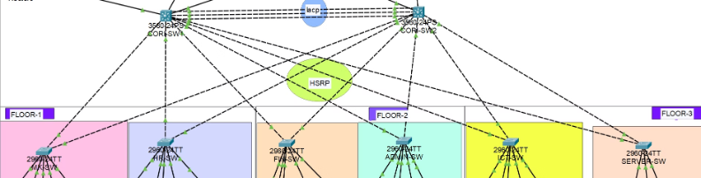
Switching Infrastructure
The switching infrastructure consists of Cisco Catalyst 3850 and 2960 switches, which provide robust local network connectivity and high performance for enterprise environments. The Catalyst 3850 switches support advanced features such as stacking, high-speed data, and application visibility, while the Catalyst 2960 switches offer reliable, entry-level access switching with Layer 2 support. Together, they ensure scalability, flexibility, and enhanced network management for CloudNexus' operations.

Slide 12

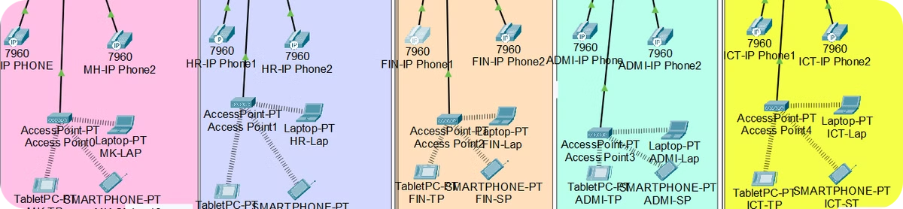
Wireless and VoIP Infrastructure
To support modern communication needs, CloudNexus is implementing a robust wireless and VoIP infrastructure:
Wireless Network
VoIP System
The wireless infrastructure consists of multiple Lightweight Access Points (LAPs) managed by two Cisco Wireless LAN Controllers (WLC). This centralized management approach ensures consistent coverage and easy administration across the facility.
A Cisco Voice Gateway will be utilized to enable phone service throughout the network. This integration allows for seamless communication between departments and with external parties.

Slide 13
IP Address Allocation
CloudNexus has assigned specific IP address ranges for different network segments to ensure efficient organization and management:
Network Segment
IP Address Range
Management Network
192.168.20.0/24
VoIP
10.10.10.0/24
DMZ
10.11.11.0/27
Public Addresses (ISP1)
105.100.50.0/30
Public Addresses (ISP2)
197.200.100.0/30

Slide 14

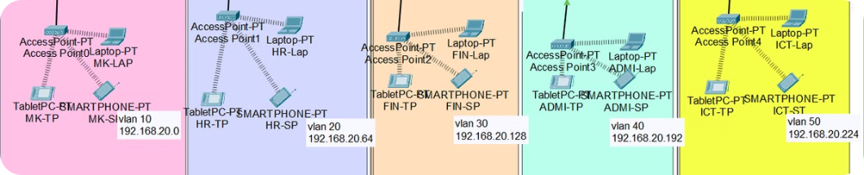
VLAN Configuration and Inter-VLAN Routing
CloudNexus will implement VLANs to segment the network logically:
1
VLAN 199: Blackhole
2
VLAN 10:
3
VLAN 20:
For unused ports
For sales & marketing
For HR & logistic
4
VLAN 120: VoIP
5
vlan 30 :
6
Vlan 40 :
For Voice over IP communications
For Accounting & financial
For Admin
7
vlan 50 : ICT
For ICT
Inter-VLAN routing will be configured on the multilayer switch to allow communication between devices in different departments. This setup ensures efficient network segmentation while maintaining necessary connectivity.

Slide 15

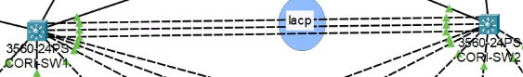

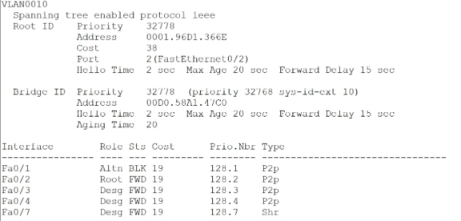
Advanced Network Features
CloudNexus is implementing several advanced network features to enhance performance, security, and reliability:
EtherChannel
Link Aggregation Control Protocol (LACP) for improved performance
STP Enhancements
BPDUguard and PortFast for faster port state transitions
OSPF
Open Shortest Path First routing protocol for efficient route advertisement

Slide 16

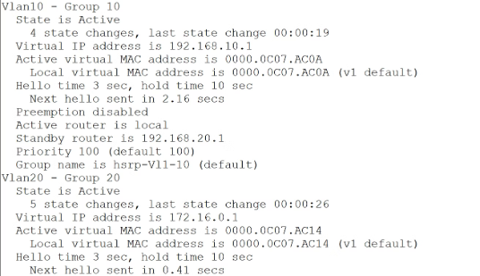

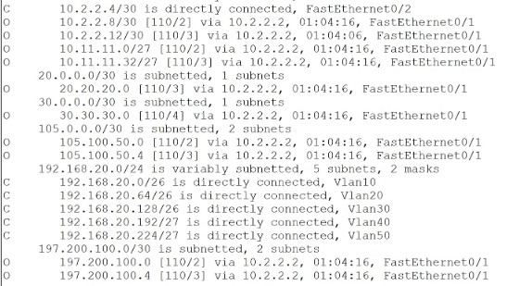
HSRP
High-availability router protocol for load balancing and failover
OSPF
Open Shortest Path First routing protocol for efficient route advertisement

Slide 17
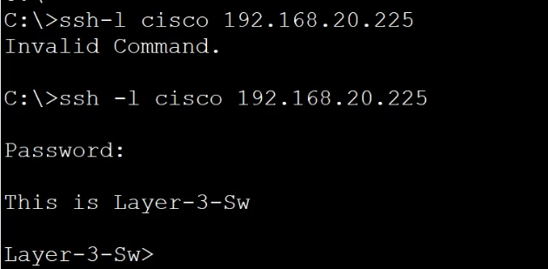
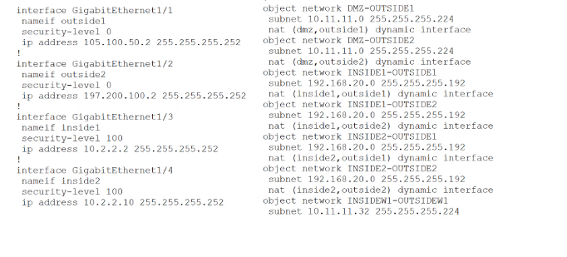
Security Measures and Access Control
To maintain a secure network environment, CloudNexus is implementing various security measures:
1
SSH Access Control
Standard ACL allowing remote administration only from the ICT PC .
2
Cisco ASA Firewall Configuration
Default static routes, security levels, zones, and policies for granular access control

Slide 18
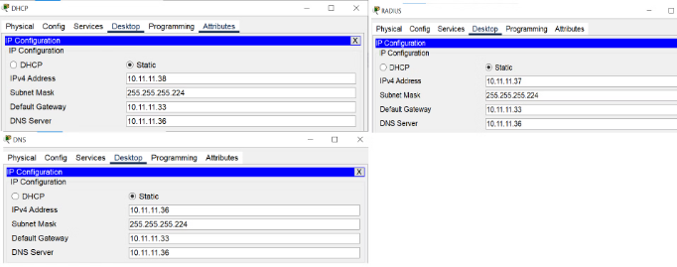
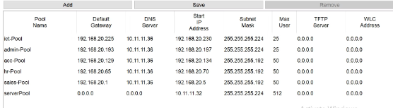
3
Static IP Addressing
Server room equipment assigned static IP addresses for consistent access
4
DHCP Server
Dynamic IP assignment for other devices, managed from the server farm

Slide 19
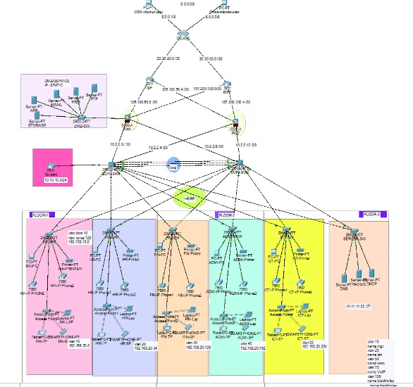
Final Network Topology and Testing
The completed network topology for CloudNexus incorporates all the discussed components and technologies. This comprehensive design ensures optimal performance, redundancy, scalability, and availability in the network infrastructure.
Before full deployment, thorough testing will be conducted to verify that all setup components work as intended, confirming correct communication across the entire network. This final step is crucial to guarantee seamless operations in CloudNexus' new facility.

